Slide 1
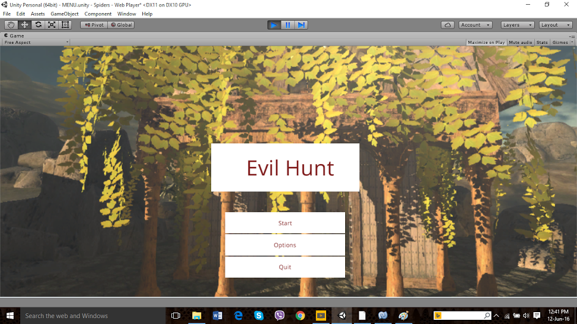

Slide 2
Evil Hunt
Supriya Parthiban
Sadaf Ahmad
Mubariz Ahmad

Slide 3
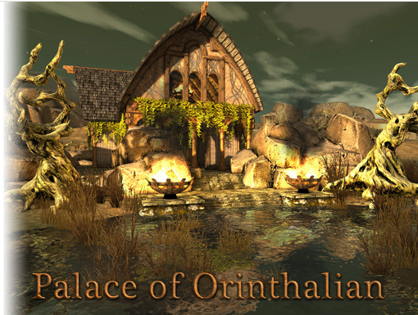

Slide 4
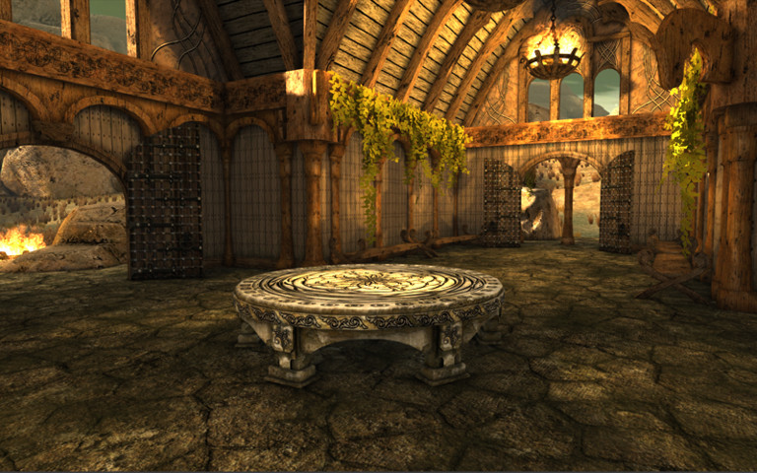

Slide 5
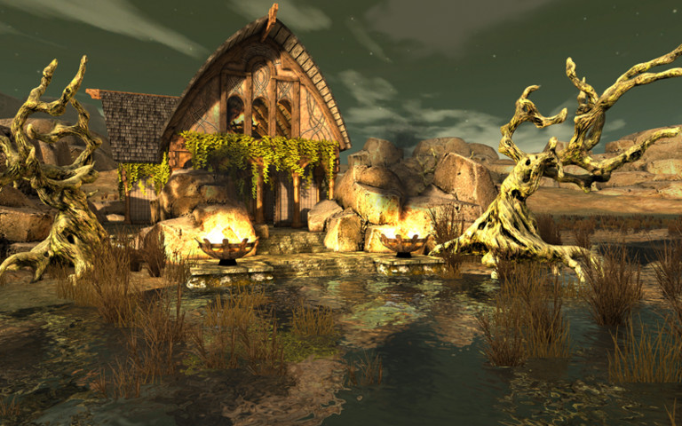

Slide 6
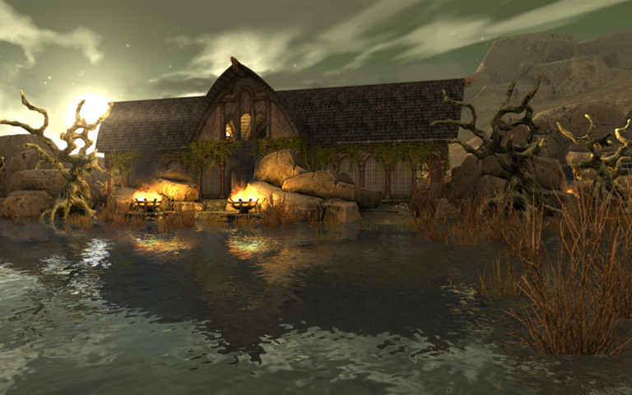

Slide 7
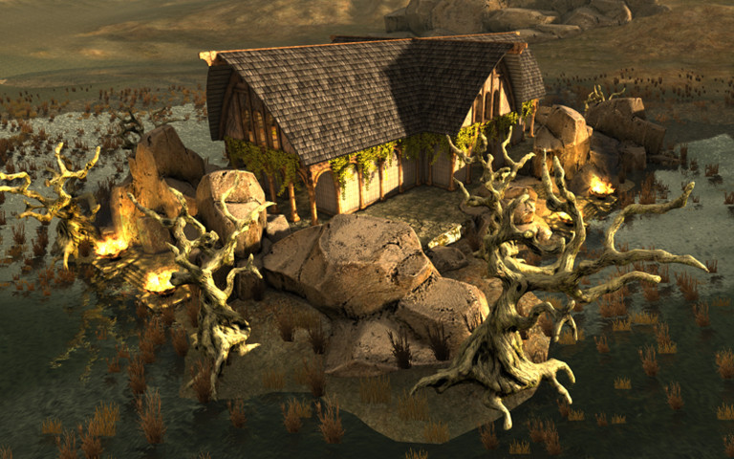

Slide 8
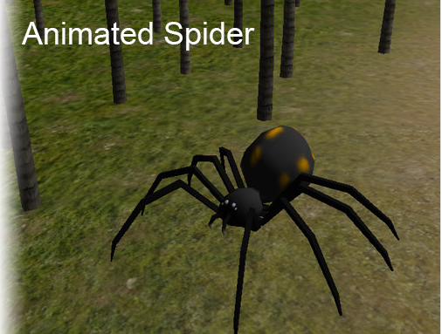

Slide 9
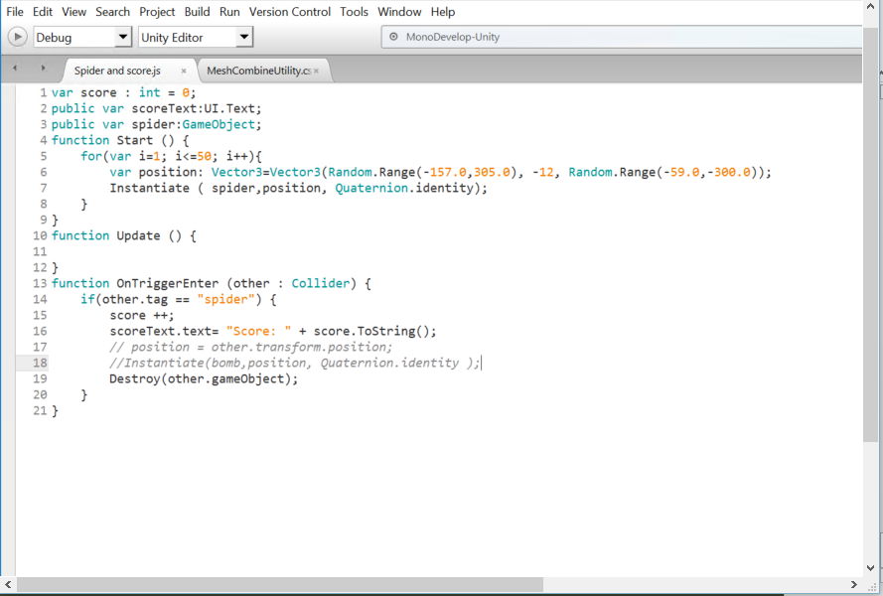

Slide 10
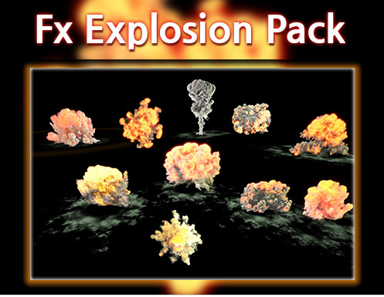

Slide 11
The Final Game

Slide 12
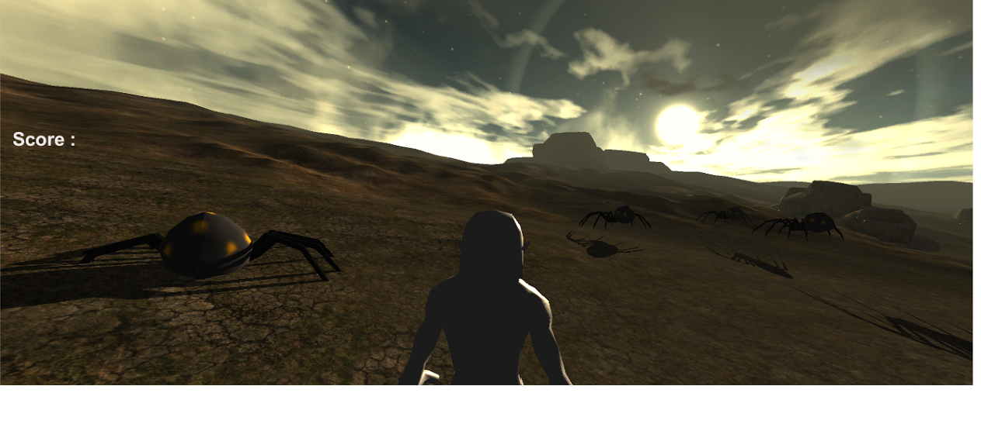

Slide 13
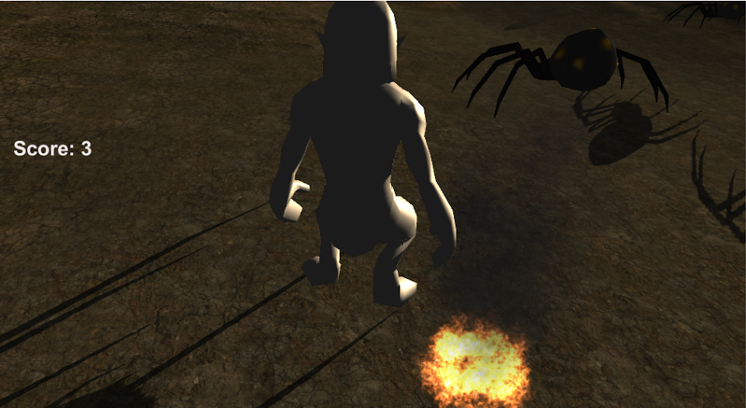

Slide 14
Future Improvements
Fine tune the animation
Insert Chest
Add a lifebar for the goblin
Make it a 2 player game
Add a map for better navigation
Have more evil characters with different abilities
Add to collect resources
Add more weapon options

